Slide 1

TOPIC 1: HUMAN RESOURCE MANAGEMENT: DEFINITIONS AND MAIN FUNCTIONS

Slide 2

1. Meaning of Human Resources

Slide 3

The term "human resource management" has been commonly used for about the last ten to fifteen years. Prior to that, the field was generally known as "personnel administration."

Slide 4
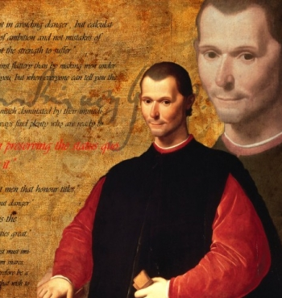
Italian politician and philosopher Niccolo Machiavelli (the author of The Emperor and other books) was not writing just about the art of the power. He was writing about managing all kinds of resources including the people, reward and recognition and various leadership styles. He was clearly splitting roles in the society; securing the position of the emperor. That is a book about Human Resources Management. However, most recommended practices would not be allowed and preferred today. He has to be mentioned in the HR Management history

Slide 5

Personnel administration, which emerged as a clearly defined field by the 1920s (at least in the US), was largely concerned the technical aspects of hiring, evaluating, training, and compensating employees and was very much of "staff" function in most organizations. The field did not normally focus on the relationship of disparate employment practices on overall organizational performance or on the systematic relationships among such practices. The field also lacked a unifying paradigm.

Slide 6
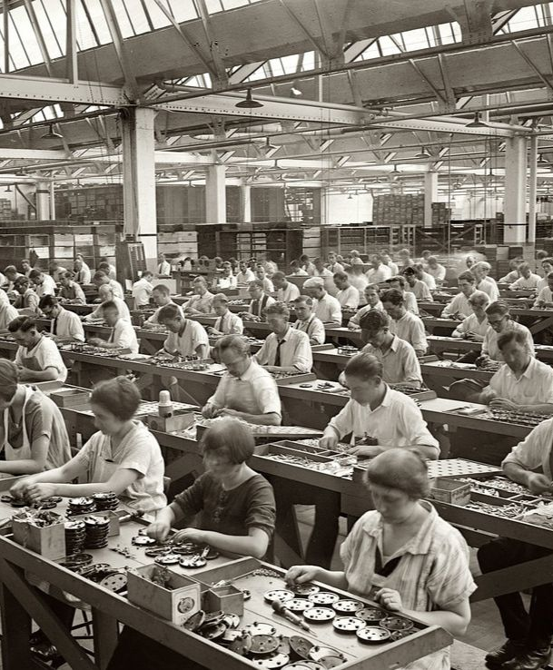
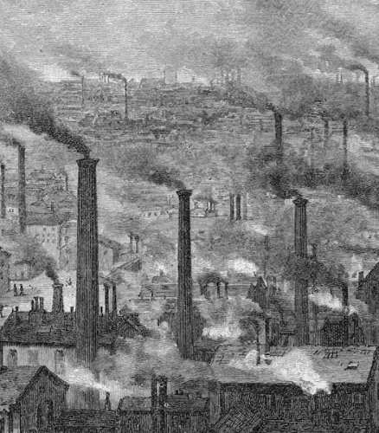
The modern history of Human Resources as we know it starts with the British Industrial Revolution. The foundation of large factories increased a demand for the workforce significantly. It was in the 18th century, and it is the moment when the evolution of new people management practices begins. It is the important landmark in the history of Human Resources. The rapid development of new industrial approaches and new inventions to work changed the world dramatically. The quick and cheap production became a priority for many industries.

Slide 7
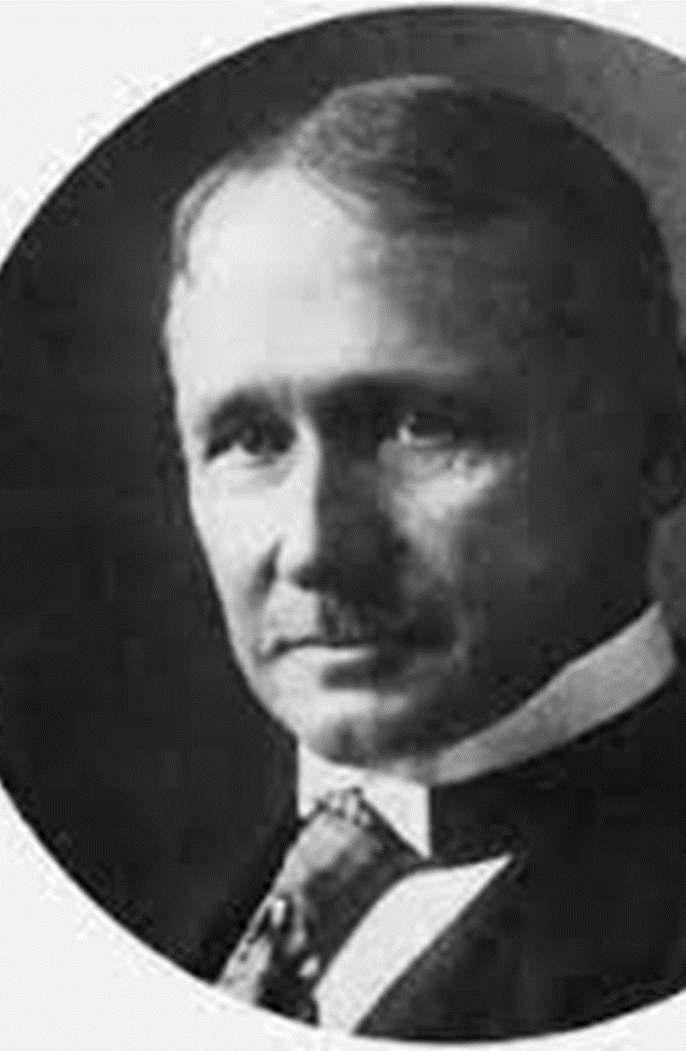
Human resource management as a specialized function in the organization began to be officially formed shortly before 1900. Until that time, most decisions regarding hiring, firing, professional training and settlement of salary issues were made by individual managers. Scientific management research conducted by Frederick Taylor and others since 1885 has helped organizational leaders identify ways to make work more efficient and reduce fatigue, thereby increasing employee productivity. The growth in the size of the organization led to the creation of the first structural units for human resources management

Slide 8
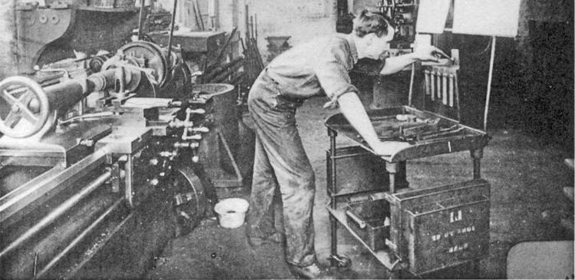
In 1911, the American Frederick W. Taylor published a book "Principles of Scientific Management"

Slide 9
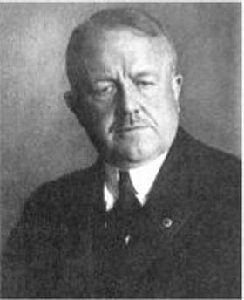
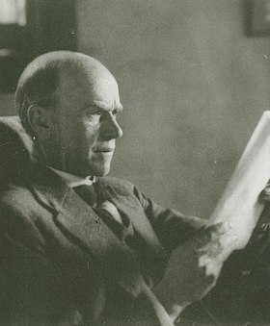
The works of Frank and William Gilbreth, related to the construction of the structure of the organization, their functions and efficiency, appeared. Research conducted by Elton Mayo in the mid-1980s revealed the impact that employers have on individual employees. Ultimately, these studies led to the development of principles and the application of methods of counseling and testing employees in organizations.

Slide 10
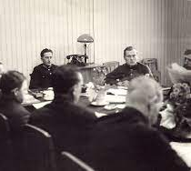
In the 1930s, the adoption of several major labor laws led to an increase in the role of trade unions. The dependence of the collective agreement and the relationship between trade unions and management followed the growth of the influence of trade unions in the 1940s and 1950s. This greatly expanded the scope of responsibility of units dealing with issues of human resource management.

Slide 11

The role of personnel services becomes more significant with the introduction of the positions of deputy heads of human resources management. The role of operational support in the field of regulating relationships between line and functional units is expanding.

Slide 12

Increased legal requirements and restrictions, which were a consequence of the development of social legislation in the 1960s and 1970s, caused serious changes in the work of human resources management. The staff of the organization had to increase their professionalism and pay more attention to various legislative subtleties regarding policy and practice. In addition, organizations began to look in a new way at the participation of employees in increasing the effectiveness of the organization's activities. As a result of automation and changes in the job structure, the productivity and quality of staff work increased.

Slide 13

In the 1980s, the strategic role of human resources management became especially important as organizations reduced their staff, closed factories or carried out structural restructuring. The transfer of workers and the professional training of those who remained became the main concern of personnel departments.

Slide 14
In the 1990s, one of the main areas of interest in human resources management is working in the conditions of diversity of the workforce, in addition, more attention was paid to the computerization of HR departments, even in small organizations. The importance of employee rights, such as drug and alcohol testing and smoking restrictions, will continue to affect human resource management.

Slide 15
Since 2000 to the present, crisis trends have led to changes in the workforce. Employees need great flexibility of the working day, provision of some benefits in the policy implemented in relation to them, which leads to the development of strategic planning, improvement of professional training, mandatory computer literacy of the staff. In general terms, the new strategic purpose of human resources management functions is to create an environment that promotes the growth of human values, which ensures the efficiency of the used resources.

Slide 16
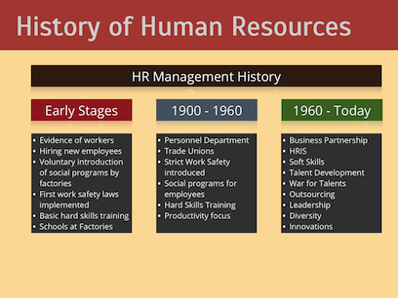

Slide 17
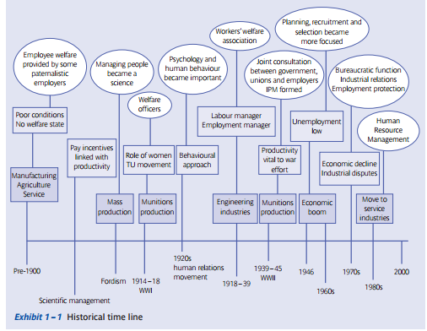

Slide 18
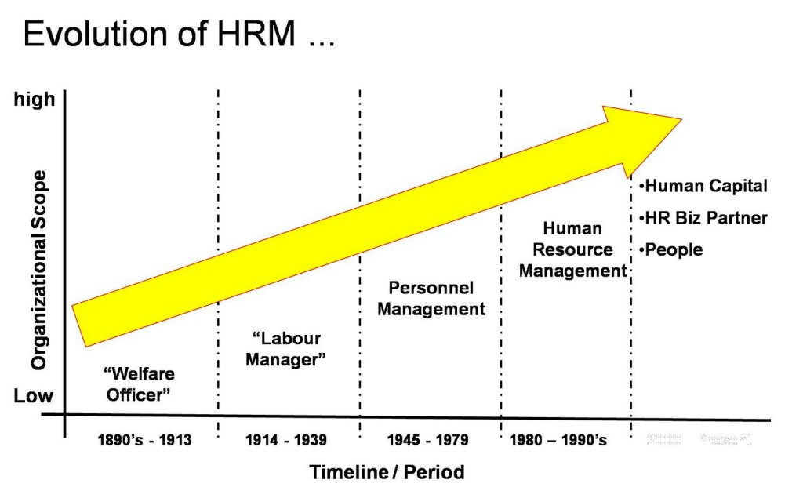

Slide 19

Human Resource Management (HRM) is defined as a system of activities and strategies that focus on successfully managing employees at all levels of an organization to achieve organizational goals.

Slide 20

HR management can be defined as: the process of analyzing and managing an organization’s human resource needs to ensure satisfaction of its strategic objectives.

Slide 21

The “human resource” of an organization is composed of all efforts, skills or capabilities of all the people who work for that organization.

Slide 22
2.Human Resources Functions

Slide 23

Human resource management functions are those tasks that are carried out in both large and small organizations during the formation and coordination of human resources.

Slide 24


Slide 25

Staffing objectives. Staffing ensures that the right staff are available at the right time in the right place.

Slide 26

Performance objectives. These are a continuation of the staffing objectives. Once the staff are in place they need to be motivated to perform

Slide 27

Change-management objectives. These are required if organizations are to be effective in developing an innovative and fast-moving organization that can keep up with the fast pace of development in a modern society.

Slide 28

Administration objectives. These need to be complied with in order for the organization to operate smoothly.

Slide 29
The functions of HRM are related to various types of management activities and include:
ensuring equal opportunities for all employees (any person's right to work) and fulfilling other obligations to the state;
carrying out a workplace analysis to determine the specific requirements of each workplace;
analysis of the capabilities of the organization's personnel, contributing to the achievement of the organization's goals;
development and implementation of a plan that implements these requirements;
recruitment of personnel that meets the needs of the organization;
selection and recruitment of personnel to fill vacancies;
staff orientation and training;
development and implementation of organization development programs;
development of employee performance evaluation systems;
assistance to employees in career planning;
development of employee payment systems;
mediating activities between the organization and trade unions;
development and implementation of health and safety programs, as well as providing assistance to employees in solving their personal problems that may affect the quality of work;
development of communication systems that ensure communication between employees, and their implementation.

Slide 30
3. The Role of HR Department

Slide 31

Role of HR Department: providing HR related consultancy and advisory services to line managers given that every manager is a human resource manager.

Slide 32

An effective human resources (HR) management department can help provide organizational structure and the ability to meet business needs by managing your business’s most valuable asset – your employees.

Slide 33

Talent Management
The talent management team in the HR department covers a lot of ground. What used to be distinct areas of the department have been rolled up under one umbrella. The talent management team is responsible for recruiting, hiring, developing, and retaining employees. Recruiters are the heavy lifters in building any company’s workforce. They’re responsible for the total hiring process including posting positions on job boards, sourcing candidates through job fairs and social media, serving as the first-line contacts for running background checks to screen candidates, conducting the initial interviews, and coordinating with the hiring manager responsible for making the final selection

Slide 34

Compensation and Benefits
In smaller companies the compensation and benefits roles can often be overseen by one or two human resources professionals, but companies with a larger workforce will typically split up the duties. HR functions in compensation include evaluating the pay practices of competitors and establishing the compensation structure. The compensation department is also responsible for creating job descriptions in tandem with department managers, as well as working with talent management on succession planning

Slide 35

Training and Development
Training and development (sometimes called learning and development) is an integral part of the HR team. Depending on the type of employee role played at the company, the training team might be responsible for building out instructional programs that have a direct effect on the success of the business. Today, many colleges and universities offer degrees in training and development; an instructional design degree would also be helpful in this role.

Slide 36

HR Compliance
Legal and regulatory compliance is a critical component of any HR department. Employment and labor laws are highly complex, and having a team devoted to monitoring this ever-changing landscape is essential to keeping companies out of trouble with federal, state, and local governments’ laws. When a business is out of compliance, it can result in applicants or employees filing claims based on discriminatory hiring and employment practices or hazardous working conditions.

Slide 37

Workplace Safety
Of course, every company wants to provide a safe place to work for its employees, and the Occupational Safety and Health Act of 1970 (OSHA) actually mandates that employers provide a safe working environment for their workers. A large focus area for HR is developing and supporting safety training and maintaining federally mandated logs in the event injuries or fatalities happen at work. In addition, this department often works hand-in-hand with benefits specialists to manage the company’s Workers’ Compensation filings.

Slide 38
HR specialists can be divided into three categories: Senior HR staff, HR advisors, HR administrators.

Slide 39

Senior HR staff – these are the HR directors and HR managers who are specialists in their work.

Slide 40


Their main role is to: formulate personnel policies for the organization;

Slide 41

get them accepted;

Slide 42

implement them;

Slide 43

advise managers of other departments about the activities related to HR functions;

Slide 44

reflect the views of the workforce to other departmental managers.

Slide 45

HR advisors – thee do not perform executive functions. Rather they act as internal consultants or advisors for the organization.

Slide 46

They mainly provide consultancy and advice on the following areas: manpower planning;

Slide 47

industrial relations;

Slide 48

management development;

Slide 49

assessment of relevant matters (e.g. impact of lasts changes in the country’s employment law).

Slide 50

HR administrators – these are the members of office staff who are responsible for all day-to-day activities of the HR department.

Slide 51

Lection is over! Thank you for your attention!

